Slide 1
Introduction to Drawing
CS 142
David Anderson
Slides by Martin Hock

Slide 2
Getting started with ResizeDrawing
Find ResizeDrawing on the Canvas page
Download it into the src folder for a project, then refresh the src folder
You can download the file elsewhere, then drag and drop it into the src folder
ResizeDrawing creates a drawing window that automatically updates, and provides a draw method that you can fill in with your own code
The draw method is called whenever the window needs to be drawn and is provided the width and height of the window along with a special Graphics object to draw with

Slide 3
ResizeDrawing code reference
import java.awt.*;
import javax.swing.*;
public class ResizeDrawing {
public static void draw(Graphics g, int width, int height) {
// Fill this in with drawing code!
}
// Leave the main method alone! It just sets up the drawing window for you.
public static void main(String[] args) {
JFrame window = new JFrame("Graphics window");
window.setLocationByPlatform(true);
@SuppressWarnings("serial")
final JPanel panel = new JPanel() {
protected void paintComponent(Graphics gx) {
Graphics2D g = (Graphics2D) gx;
int width = getWidth(), height = getHeight();
g.clearRect(0, 0, width, height);
g.setRenderingHint(RenderingHints.KEY_ANTIALIASING, RenderingHints.VALUE_ANTIALIAS_ON);
g.setBackground(Color.WHITE);
g.setColor(Color.BLACK);
draw(g, width, height);
}
};
Dimension d = Toolkit.getDefaultToolkit().getScreenSize();
window.setSize(d.width / 2, d.height / 2);
window.setBackground(Color.WHITE);
panel.setBackground(Color.WHITE);
window.setContentPane(panel);
window.setVisible(true);
window.setDefaultCloseOperation(JFrame.EXIT_ON_CLOSE);
}
}

Slide 4
Drawing a circle
The following code placed into the draw method should draw a circle: g.drawOval(x, 0, 100, 100);

Slide 5
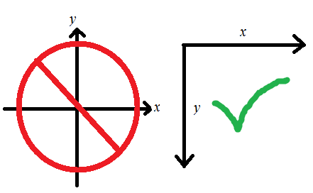
Coordinate system
Instead of the origin (0,0) being at the center of the screen and y increasing as you go up, the origin is in the upper left corner of the screen and y increases as you go down (x increases to the right as usual)
This is similar to the way CRT monitors function (and similar to English reading order)

Slide 6
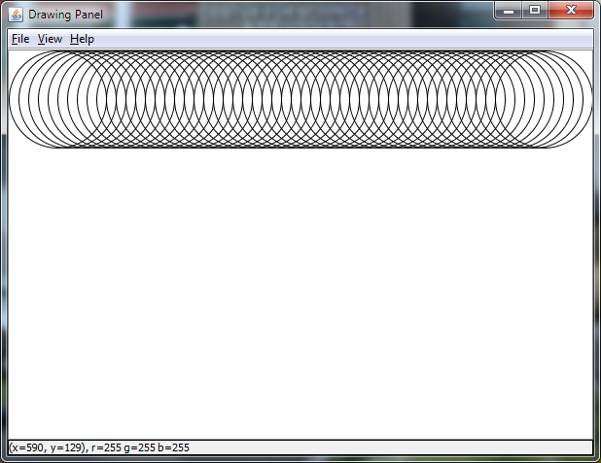
Drawing a line of circles across the window
Replace the statement that calls drawCircle with the following code: int x = 0; while (x + 100 <= width) { g.drawOval(x, 0, 100, 100); x += 10; }

Slide 7
Breaking up the loop code into pieces
We started by defining a variable that will change over time: int x = 0;
Then, we defined with a condition: “as long as we won’t draw the circle off the edge of the window, keep going” while (x + 100 <= width) {
Inside the loop, we drew the circle that we wanted: g.drawOval(x, 0, 100, 100);
Finally, inside the loop, we incremented x to draw the next circle: x += 10;

Slide 8
for loop
for loops are more structured than while loops
Most loops are structured in a way that can be expressed clearly and succinctly as a for loop
Initializer: can be any Java statement but usually sets up a variable that will be checked in the check part and modified in the increment
Check: same as a while condition, run at the start of each loop-thru
Increment: run at the end of each loop, usually modifies the variable
for (<initializer>; <check>; <increment>) <statement-or-block>

Slide 9
Restating the loop as a for loop
for (int x = 0; x + 100 <= width; x = x + 10) { g.drawOval(x, 0, 100, 100); }

